Slide 1
Region 1 OCT
ETDD N RPO 3-Year Plan Update
Region 1 PD

Slide 2
Criteria
Maximize Safety and Security
Preserve & Manage Existing Transportation System
Support the State’s Economy
Build Partnerships for Livable Communities
Move a Growing, Diverse, Active Population
Promote Stewardship of the Environment
Maximize Safety and Security
Support the State’s Economy
Build Partnerships for Livable Communities

Slide 3
Timeline
November – The project lists are distributed to the RPO’s/MPO’s for ranking during their November/December meetings.
December - local/regional ranks are returned to TDOT with comments.
January – March – Development of the Comprehensive Multimodal Program
April/May – Public Release of the approved Highway Program.
Notes:
Every year in November/December, we give the draft list of projects to the MPO’s and RPO’s and we have them rank and prioritize the project phases. From January through April, TDOT is developing the Comprehensive Multimodal Program which gets approved by the Governor of Tennessee and the Legislators of Tennessee. Then sometime in April, TDOT provides the approved Highway Program to the public.

Slide 4
Criteria Weight
TRAFFIC OPERATIONS 25.8%
Multimodal/Func. Class 4.2 %
Economic Development 16.7%
Roadway Safety
26.3%
Region/MPO/RPO Rank
23.6%
Environmental lmpact
3.4%

Slide 5
Summary
Projects Ranked based on:
Technical Score
Investment (Cost of the Phase of Work)
Funding Source
Scheduling Constraints
Additional Ranking Considerations
Even Distribution of Projects per Region
Phase of development (PE/ROW/CONST)
MPO/RPO distribution

Slide 6
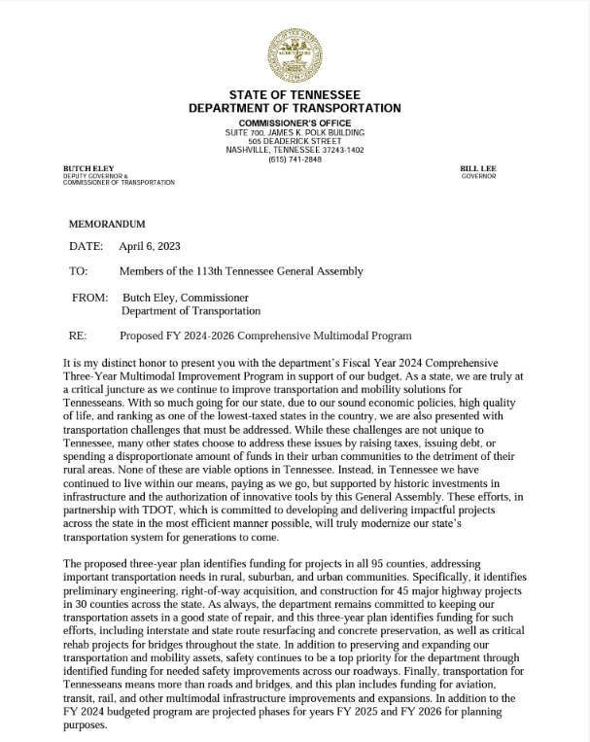
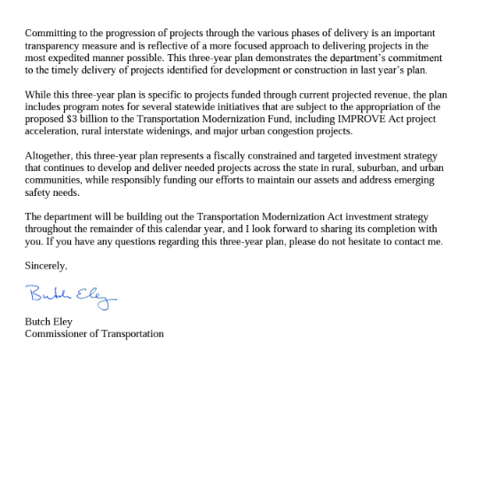
TDOT Three-Year Plan

Slide 7
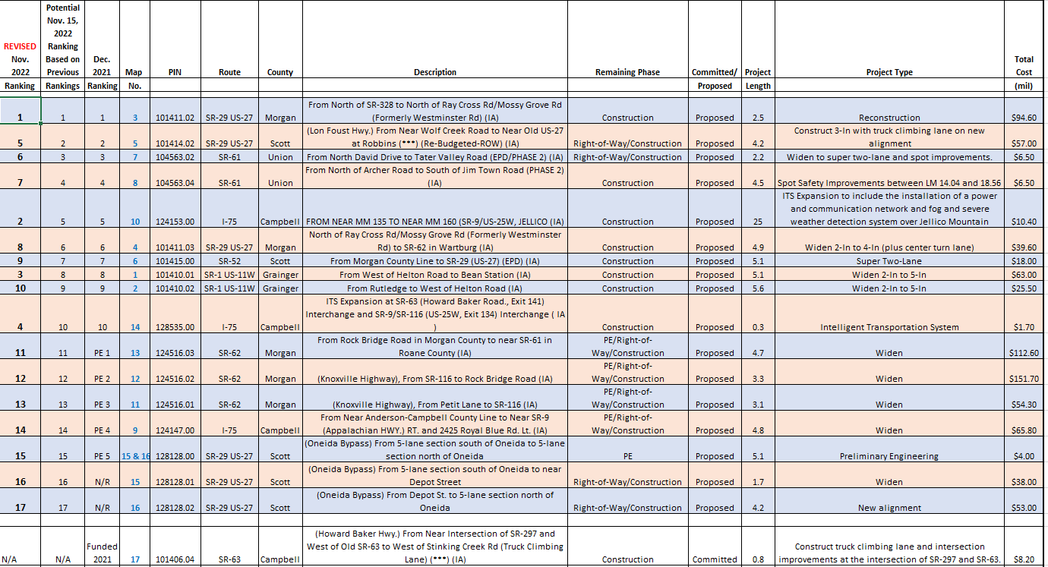
ETDD RPO N Ranking Results
CN 24

Slide 8
Questions?
Christie Brown, PE | Civil Engineering Manager 2
Region 1 Project Development
p. 865.594.0742
Christie.Brown@tn.gov
Troy J Ebbert | Planning Supervisor
Region 1 Long Range Planning
O: 865.594.2662 C: 865.253.1436
Troy.J.Ebbert@Tn.Gov

