Slide 1
Infrastructure Investment Jobs Act (IIJA) Programs Updates
May 2023

Slide 2
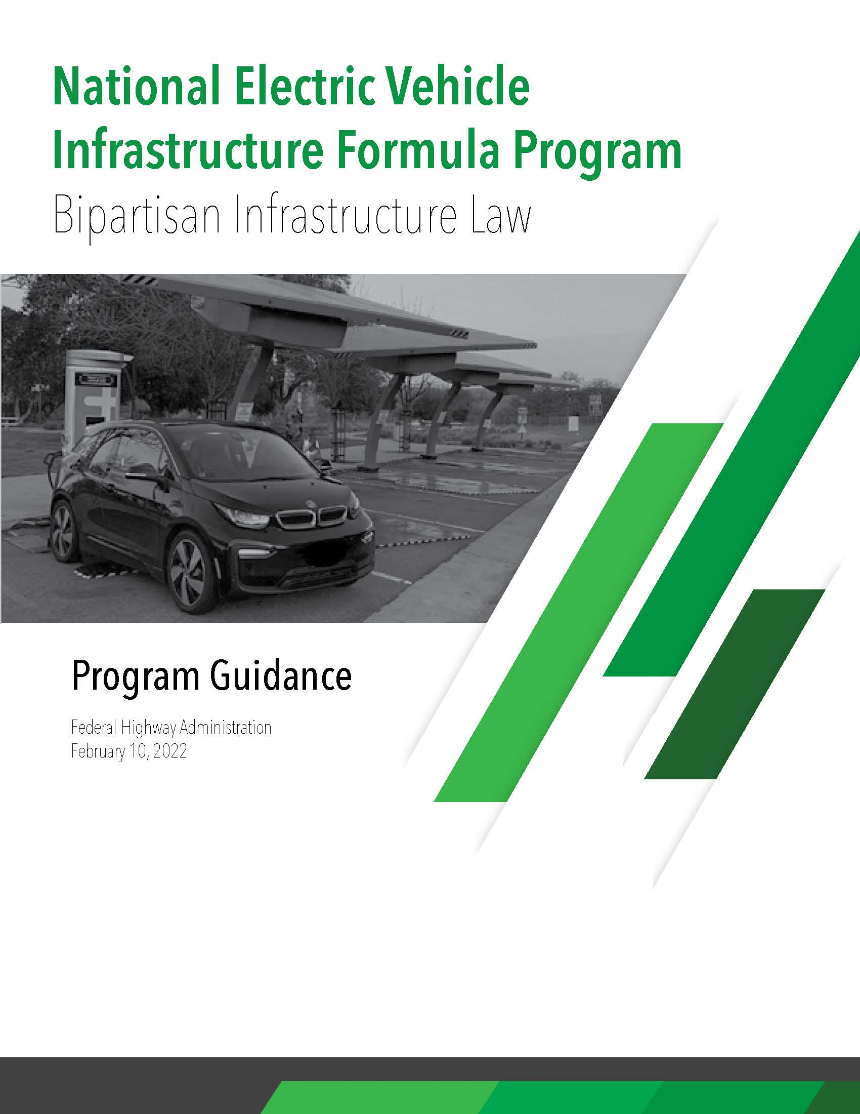
NEVI Program Funding
$7.5 billion in dedicated funding to expand electric vehicle (EV) charger accessibility to all Americans.
$2.5 billion competitive, discretionary grant program FHWA led -NOFO opened March 14, Closes May 30, 2023
1.25 billion – Corridor Charging grants (TDEC is applying on behalf of the state. Focus – Freight charging along AFC’s.
1.25 Billion – Community Charging grants (open to MPO's)
$5 billion formula program (NEVI Program)
$88 million over 5 years to Tennessee (TEVI Deployment Plan)
February 10, 2022
Notes:
The NEVI program has released 7.5 billion nationally. 2.5 billion that FHWA will administer as competitive grants. The other 5 billion was apportioned to states to fulfill the requirements of adding a DC-Fast charging station at least every 50-miles along the designated alternative fuel corridors, with 4 charging ports at each location, within 1-mile of an exit, and capable of delivering 150kW or power to each port. TN will receive 88 million.

Slide 3
TDOT Formula Funding
Notice of Intent - Released March 17
Notice of Funding Opportunity (grant) – Spring 2023
Awards – late summer (August/September)
Contracts – Fall 2023
Notice to Proceed – winter/spring 2024
There are 10 existing NEVI compliant charging stations in TN (red squares)
Notes:
The notice of intent (to grant these funds) was released on March 17 and we expect the Notice of Funding to be released as a grant in late spring 2023. With this schedule we wouldn’t expect to see any ground breaking until next spring. There are currently only 10 existing NEVI compliant (DC fast charge stations along the alternative fuel corridors) we expect to add approximately 30 more charging stations through this funding opportunity.

Slide 4
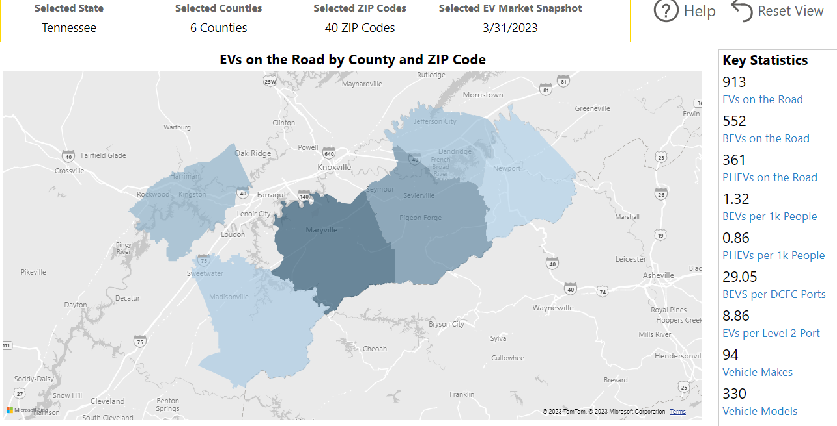
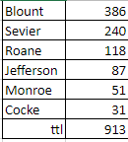
Current State
EV Registrations (March 2023)
Existing Infrastructure
State EV Registration Data – Atlas EV Hub
Alternative Fuels Data Center
www.afdc.energy.gov
BEV = Battery Electric
PHEV = Plug-in Hybrid Electric
Notes:
As of March 2023, TN had almost 26 thousand EV’s registered (BEV’s + PHEV’s).. Compared to the top 4 counties in the state (Davidson -4,433, Williamson -4,223, Knox -3,118, Shelby -2,983).
As of March 2023, there were 625 existing public EV stations (level 2 and DC Fast charge combined). We have included the links to websites if you want to explore for yourselves.

Slide 5
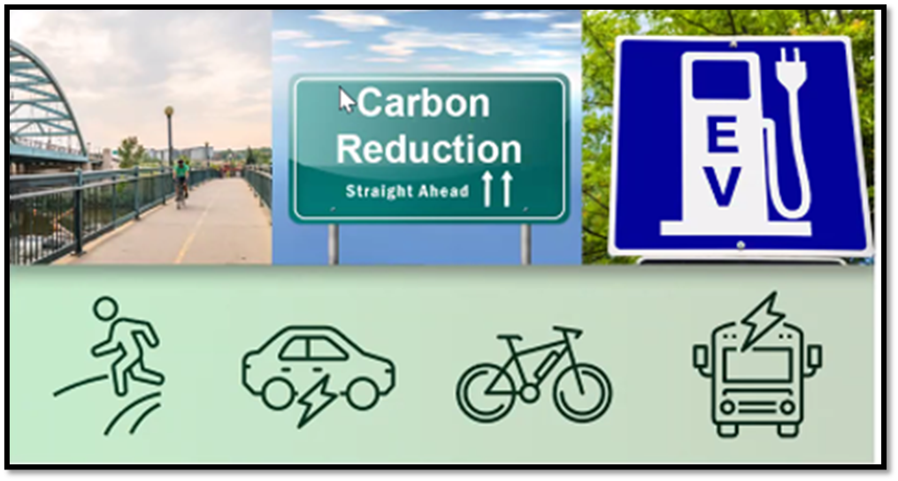
Carbon Reduction Program
$6.4 billion Nationally, (FY2022 – FY2026)
$6.4 billion formula program (allocated to state DOT’s)
TN portion is $139,172,276
(over the 5-year period)
Funding for projects to reduce Transportation Emissions Reductions.
States must develop a Carbon Reduction Strategy
Submit for approval by November 15, 2023
Identify alternatives to single occupant vehicle trips.
Identify vehicles or modes of travel that result in lower transportation emissions.
Identify construction practices that result in lower emissions.
Notes:
TN will receive approximately $139 million over the 5-year period, from 2022-2026, to implement Carbon Reduction projects. TDOT programs office is working with AECOM to develop a strategy plan, which is due to FHWA in November 2023.

Slide 6
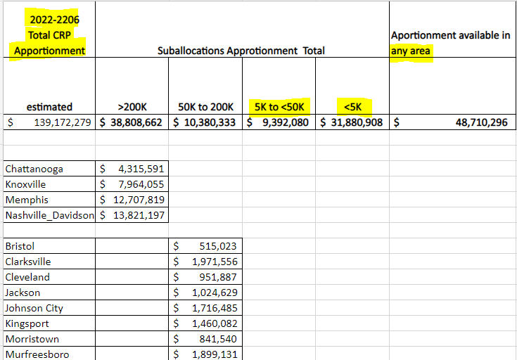
Carbon Reduction Program (CRP)
What’s unique about CRP?
65% of funds apportioned to a state are obligated by population.
Meaning all MPO’s have been given a pre-determined suballocation.
The 4 TMA’s have project selection authority within their boundaries.
TDOT has project selection authority for all other population categories.
35% of funds may be obligated anywhere in the state at the DOT’s discretion.
MPO’s can program their allocations prior to the states’ strategy plan.
TDOT developed a survey to help determine what types of project were important to each population category. The survey closed on May 5, 2023. The results from the survey will inform the decision for developing carbon reduction projects.
Notes:
The funds are allocated to population categories based upon urbanized boundaries. TDOT’s AQ office will work with the city and MPO to determine suitable projects for this area.
TDOT sent out a survey to get an idea of the project types most desired by stakeholders.

Slide 7
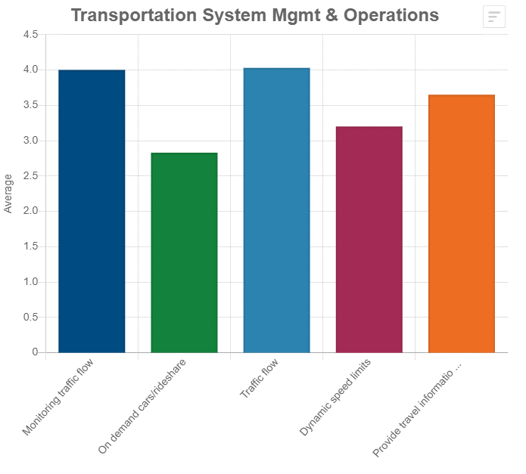
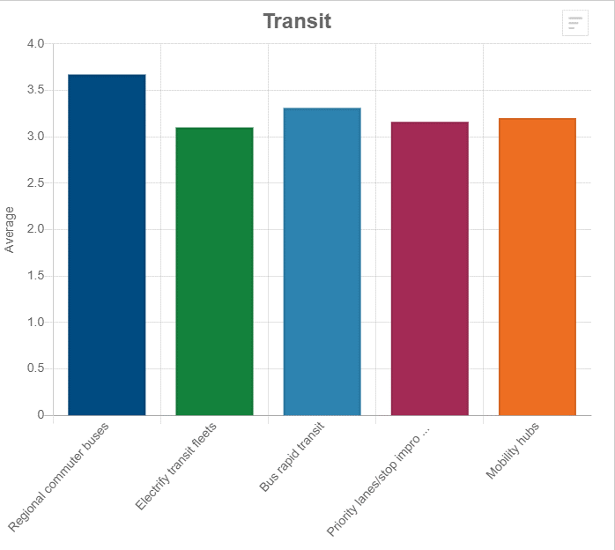
Carbon Reduction Program
Statewide, TSMO and Transit were ranked highest
Strategies Ranking
TSMO
Traffic Flow
Monitoring traffic flow
Travel information
On demand cars / rideshare
Dynamic speed limits
Transit
Regional commuter buses
Bus rapid transit
Electrify Transit Fleets
Priority Lanes and Mobility Hubs
*of note – Street Lighting ranked very high even though Green Construction was not high as a category.
Notes:
We had 120 people statewide complete the survey. The survey just closed a few days ago so we only have statewide data but in a few weeks we will have an analysis for each population category. This isn’t so important in the 4 TMA’s but for the other population categories, the AQ office will be working to develop projects based upon these results.

Slide 8
Carbon Reduction Program
Ranking strategies
Survey Results
Notes:
Overall TSMO, Transit and TDM strategies were ranked highest.

Slide 9
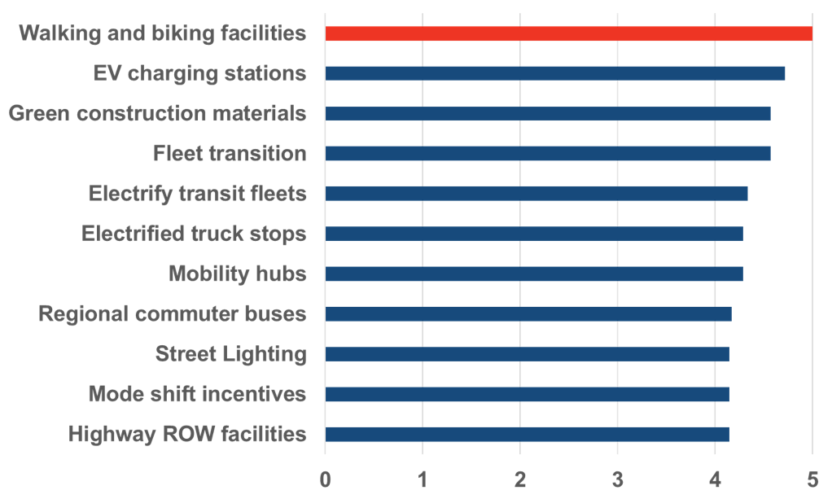
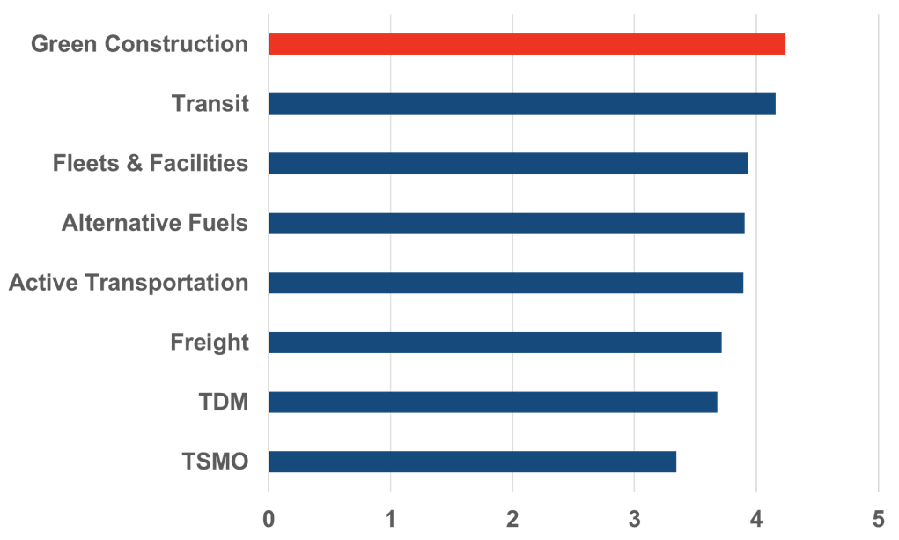
East Tennessee South Priorities
Ranked Project Types
Ranked Strategies
Notes:
In the ETS 7 surveys were completed.

Slide 10
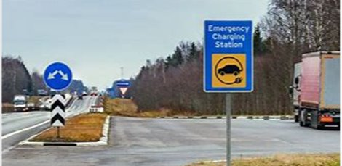
PROTECT Program
Promoting Resilient Operations for Transformative, Efficient, and Cost-saving Transportation
$8.7 billion Nationally, (FY2022 – FY2026) is comprised of:
$7.3 billion formula program (allocated to state DOT’s)
$1.4 billion competitive, discretionary grant program
Tennessee’s allocation is $158 million over the 5 years
*Electric charging infrastructure along evacuation routes is an eligible expense.

Slide 11
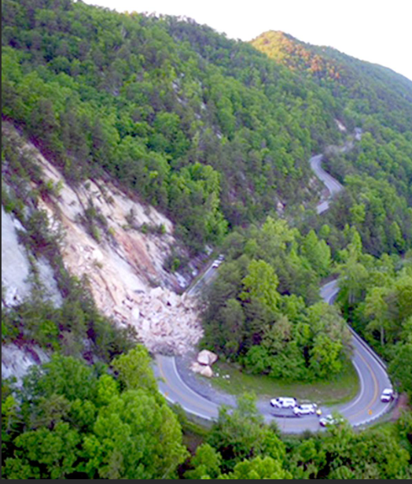
Resiliency Planning
Resilience plans/studies – Consultants will review transportation assets, assess their vulnerability and provide resilience-building solutions.
Competitive Grants Proposed Timeline
October 2023 - Announce grant opportunity
Application
Webinar
December 2023 – Grant closes
January 2024 – Review applications
Put forth recommendations to commissioner
March 2024 – Announce awards
March – April 2024 – contracts with consultants
May 2024 – Kick- off plans/studies
resilience planning,
predesign, or design;
technical capacity-building;
evacuation planning and preparation.
Set-aside for Resilience-Related Planning​
Requires each State to use at least 2% of its PROTECT Formula Program funding each fiscal year for specified types of resilience-related planning.
Notes:
The PROTECT program requires states to use at least 2% of their formula funds for planning activities. TDOT intends to release a competitive grant for local agencies (including transit agencies) to develop resiliency related activities (see list above). We hope to open applications in fall 2023. It is never too early to start thinking about submitting an application.

Slide 12
Conclusion
This new funding is a monumental event, coming at a time when available workforce is also at a monumental low.
We will all need to work together to implement these transformative programs.
Feel free to reach out to me, I always welcome your feedback.
Andrea Noel
TDOT Programs Office
Andrea.noel@tn.gov
423-453-1196
Notes:
GM EV1 introduced in 1996.

